Slide 1
Recurrent Algorithms
Divide-and-conquer principle:
to divide a large problem into smaller ones and recursively solve each subproblem, then
to combine solutions of the subproblems to solve the original problem
Running time: by a recurrence relation combining the size and number of the subproblems and the cost of dividing the problem into the subproblems

Slide 2
“Telescoping” a Recurrence
Recurrence relation and its base condition (i.e., the difference equation and initial condition):
T(n) = 2⋅T(n−1) + 1; T(1) = 1
Closed (explicit) form for T(n) by “telescoping”:

Slide 3
“Telescoping” ≡ Substitution

Slide 4
Basic Recurrence: 1
Closed (explicit) form by “telescoping”:

Slide 5
1: Explicit Expression for T(n)

Slide 6
Guessing to Solve a Recurrence
Infer (guess) a hypothetic solution T(n); n ≥ 0 from a sequence of numbers T(0), T(1), T(2), …, obtained from the recurrence relation
Prove T(n) by math induction:
Base condition: T holds for n = n_{base} ,e.g. T(0) or T(1)
Induction hypothesis to verify: for every n > n_{base}, if T holds for n − 1, then T holds for n
Strong induction: if T holds for n_{base}, …, n - 1, then…

Slide 7
Explicit Expression for T(n)
T(1) = 1; T(2) = 1 + 2 = 3; T(3) = 3 + 3 = 6;
T(4) = 6 + 4 = 10 ⇒ Hypothesis:
Base condition holds: T(1) = 1∙2 / 2 = 1
If the hypothetic closed-form relationship T(n) holds for n − 1 then it holds also for n:
Thus, the expression for T(n) holds for all n > 1

Slide 8
Basic Recurrence: 2
Repeated halving principle: halve the input in one step:
“Telescoping” (for n = 2^{m}):

Slide 9
2: Explicit Expression for T(n)

Slide 10
Basic Recurrence: 3
Scan and halve the input:
“Telescoping” (for n = 2^{m}):

Slide 11
3: Explicit Expression for T(n)

Slide 12
Basic Recurrence: 4
“Divide-and-conquer” prototype:
“Telescoping”:
For

Slide 13
4: Explicit Expression for T(n)

Slide 14
General “Divide-and-Conquer”
Theorem: The recurrence
with integer constants a≥1 and b≥2 and positive constants c and k has the solution:
Proof by telescoping:

Slide 15
General “Divide-and-Conquer”
Telescoping:

Slide 16

Recursion Example
long factorial( int n )
{
if( n <= 1 )
return 1;
else
return n*factorial(n- 1);
}
In terms of big-Oh:
t(1) = 1
t(n) = 1 + t(n-1) = 1 + 1 + t(n-2)
= ... k + t(n-k)
Choose k = n-1
t(n) = n-1 + t(1) = n-1 + 1 = O(n)
Consider the following time complexity:
t(0) = 1
t(n) = 1 + 2t(n-1) = 1 + 2(1 + 2t(n-2)) = 1 + 2 + 4t(n-2)
= 1 + 2 + 4(1 + 2t(n-3)) = 1 + 2 + 4 + 8t(n-3)
= 1 + 2 + ... + 2^{k-1} + 2^{k}t(n-k)
Choose k = n
t(n) = 1 + 2 + ... 2^{n-1} + 2^{n} = 2^{n+1} - 1

Slide 17
Another Approach (Recursive Tree Method)
T(n) = 2T(n/2) + O(n) , T(1) = O(1)
T(n) = T(n/2) + T(n/2) + cn = cn
T(n/2^{k}) = T(1) where k= height,
K= lgn
O(n) = O(height * number of leaves)
= O(k*n)=O(nlgn)
=
cn
T(n/2)
T(n/2)
c(n/2)
c(n/2)
height
T(n/4)
T(n/4)
T(n/4)
T(n/4)
T(1)
T(1)
No of leaves

Slide 18
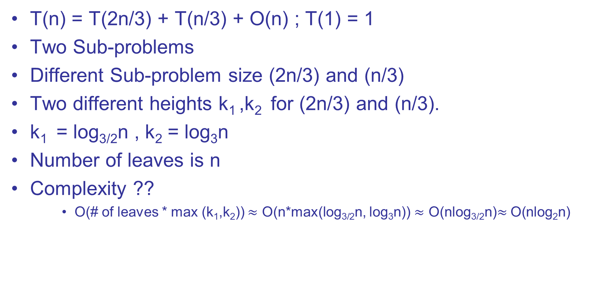
Another Example
T(n) = T(2n/3) + T(n/3) + O(n) ; T(1) = 1
Two Sub-problems
Different Sub-problem size (2n/3) and (n/3)
Two different heights k₁ ,k₂ for (2n/3) and (n/3).
k₁ = log_{3/2}n , k₂ = log₃n
Number of leaves is n
Complexity ??
O(# of leaves * max (k₁,k₂)) $≈$ O(n*max(log_{3/2}n, log₃n)) $≈$ O(nlog_{3/2}n)$≈$O(nlog₂n)

Slide 19
Capabilities and Limitations
Rough complexity analysis cannot result immediately in an efficient practical program but it helps in predicting of empirical running time of the program
“Big-Oh” analysis is unsuitable for small input and hides the constants c and n₀ crucial for a practical task
“Big-Oh” analysis is unsuitable if costs of access to input data items vary and if there is lack of sufficient memory
But complexity analysis provides ideas how to develop new efficient methods

